Slide 1
Case Study on Flight dataset

Slide 2
OBJECTIVE
We need to predict Whether flight will be delayed/Cancelled or is on time using given meta data.
The labels are missing, from dataset which is created using data provided latter.

Slide 3
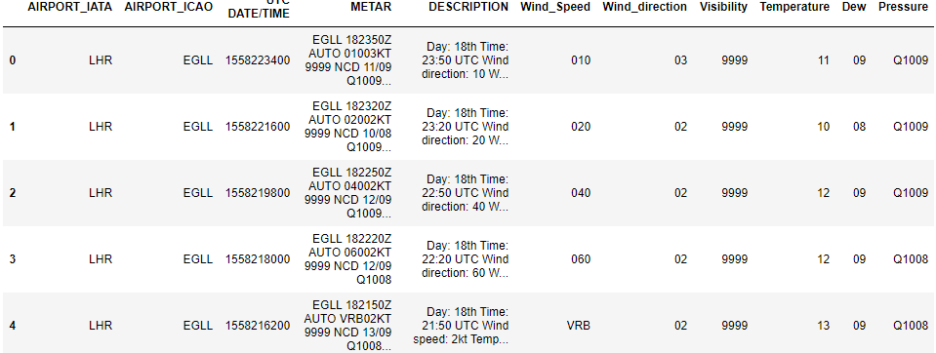
MATER.CSV
Converted the datetime format to UTC format
Extract the feature like Wind direction, Wind speed, Temperature, Dew point, Pressure, Visibility from METAR column using Regular expression(Regex)

Slide 4
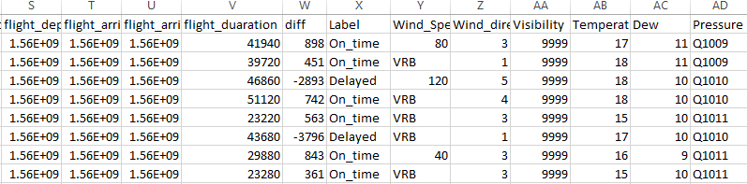
Arrival and departure + MATER
Concatenation is done for Arrival +Mater and Departure +Mater comparing
flight_destination_code_icao with AIRPORT_IATA
And flight_destination_code_iata lying between UTC and UTC -1800
Thereby adding extra feature that will be used for modelling.

Slide 5
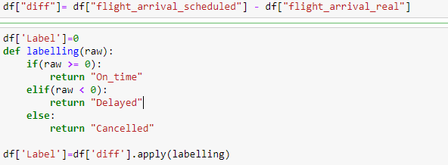
Label Creation
Based on the difference between, flight_arrival_scheduled and flight_arrival_real, labels are decided, one among the three(On_time, Delayed and Cancelled).
For cancelled flight, flight_arrival_real is missing.

Slide 6
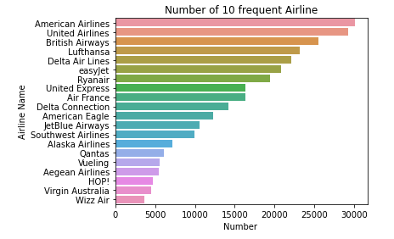
Data Exploration
Top 10 frequent Airline

Slide 7
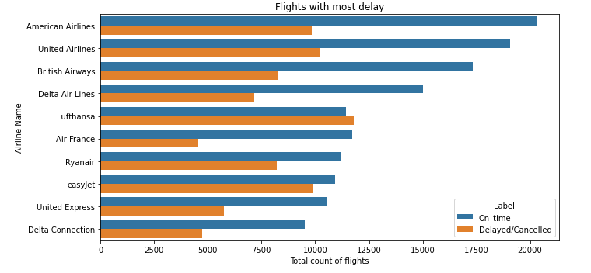
Frequent Flight with their delay and timings
Lufthansa and EasyJet are most probable for cancellation

Slide 8
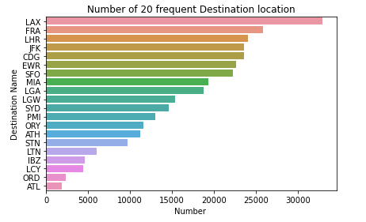
Airport with most Flights

Slide 9
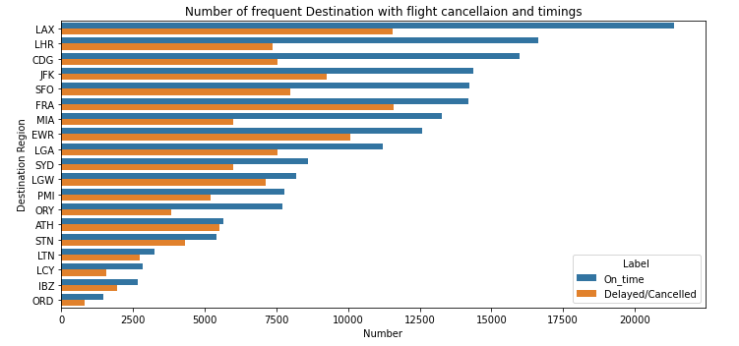
Cancellation and delay at these busiest Airports

Slide 10
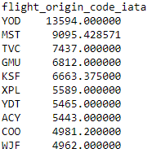
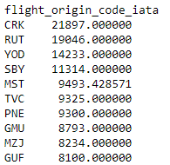
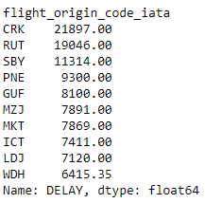
Average arrival delay at particular airport
Average Destination delay at particular airport
Delay at Airport

Slide 11
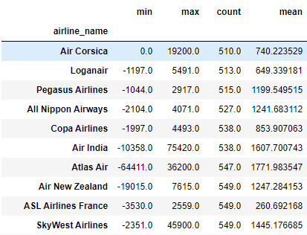
Minimum, Maximum and Average delay of Air Lines

Slide 12
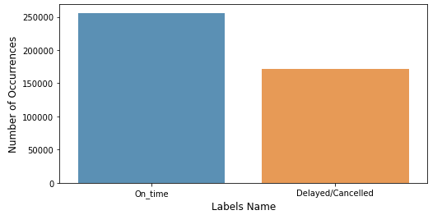
Model Creation
Among the mentioned feature Pearson correlation is performed to remove correlated features.
As the dataset is found to be balanced between On_time and (Delayed/Cancelled), so the Evaluation metrics chosen is Accuracy.
Model implemented are LinearSVC, LogisticRegression and lightgbm Ensemble model.

Slide 13
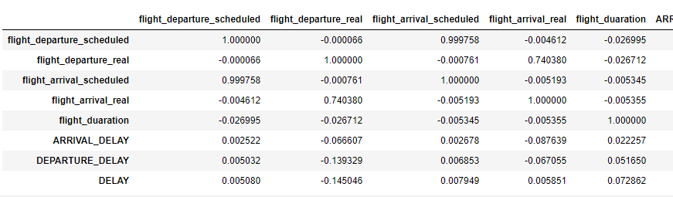
CORRELATION CHECK
Using correlation metrics, Removed the related features using Pearson correlation
flight_departure_scheduled and flight_arrival_scheduled with .99 correlaction
flight_departure_real and flight_arrival_real with .79
Arrival_delay and departure delay with .806

Slide 14
Modelling results:
Model which outperformed is Linear SVC and lightgbm with an accuracy of 72.4%
Most important feature for classification is Flight_origin_code_iata

Slide 15
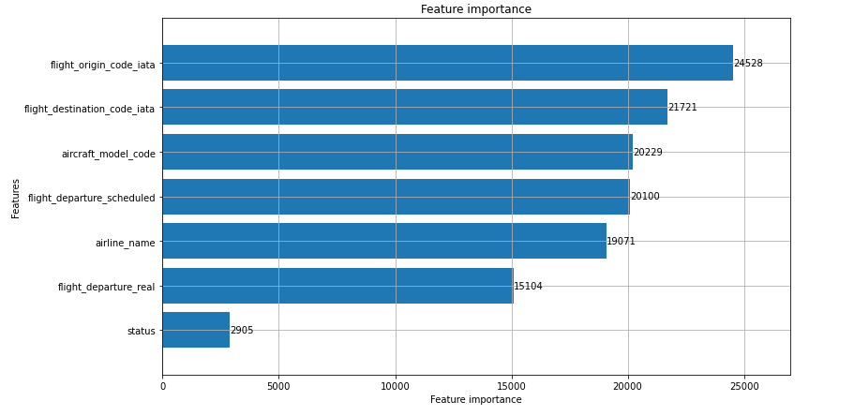

Slide 16
Thank You

